Slide 1
Recognizing emotions in text
using ensemble of classifiers
Isidoros Perikos
Ioannis Hatzilygeroudis
Department of Computer Engineering & Informatics, University of Patras, 26504 Patras, Greece

Slide 2
1
Context
2
State of the art
3
Problematic
4
Objective
5
Proposed solution
Plan
6
Experimentation
7
Evolution of results
8
Conclusion
Jaafer klila
Recognizing emotions in text
2

Slide 3



Context
Emotions are a condition that we use to express our feelings.
Common way for people to express their emotion
Text
Speech
Facial expression
Jaafer klila
Recognizing emotions in text
3

Slide 4
Context
Humans can easily recognize a person's emotion through communication in natural language
people also communicate with machines, the common way is by using text(comments, posts…).
The work presented in this paper is related to the area of Recognizing emotions which focuses on emotions in text
The main objective of this paper is to present a group of a classification system to analyze sentiment in text data
Jaafer klila
Recognizing emotions in text
4

Slide 5

Context
Why is it important to recognize emotion automatically?
Academic research:
For E.g.” what is the public sentiment towards covid vaccine?
E.g.” what do people think of our product?
Jaafer klila
Recognizing emotions in text
5

Slide 6
State of the art
There are 11 relevant works in this field
Alm et al.
Xia et al.
Da Silva et al.
Xia et al.
2011
2014
2005
2011
Automatic classification using machine learning to recognize emotion in tweets(Random forest, SVM, multinomial
naïve Bayes and logistic regression.
Create a method to identify the polarity of a sentence in a text
Automatic classification using machine learning
Focus on sentences in children’s fairy tales.
Jaafer klila
Recognizing emotions in text
6

Slide 7

State of art
Limits:
All existing approaches use machine learning
examination of the sentences doesn’t include semantic and syntactic features (non-context sensitive) and is based only on keywords
We need a new approach to recognize emotion in text
Jaafer klila
Recognizing emotions in text
7

Slide 8
Problematic
Recognition emotion in text is a complex study, need a deep analysis to achieve good results.
Machine learning doesn’t able to analysis semantic and syntactic features of a sentence.
Some words in a sentence have different meaning according to the usage and context
Jaafer klila
Recognizing emotions in text
8

Slide 9
objective
The main objective of this paper is to develop a model can analyze the semantic and syntactic the sentence.
Identify the meaning of words in a sentence according to the usage of content.
Jaafer klila
Recognizing emotions in text
9

Slide 10
Proposed solution
Automatic emotion recognition technology
statistical classifier
knowledge-based tool
Maximum Entropy learner
Naïve Bayes
Jaafer klila
Recognizing emotions in text
10

Slide 11
Proposed solution
The system is based on three main models, two statistical models, and a knowledge-based classifier tool.
naïve Bayes learner and maximum entropy leaner are statistical classifiers trained on ISEAR (International Survey on Emotion Antecedents and Reaction)and Affective Text datasets and the knowledge-based tool analyses the structure of a sentence
Jaafer klila
Recognizing emotions in text
11

Slide 12
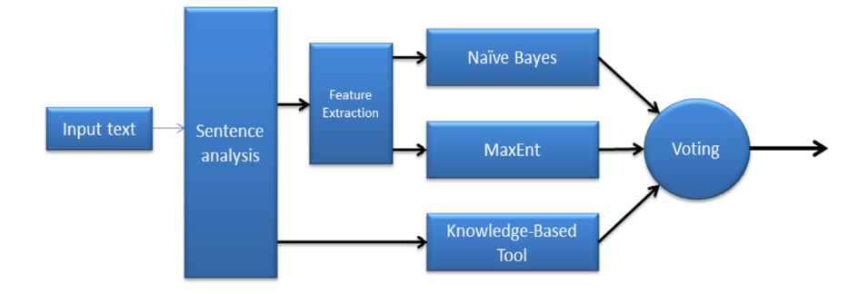

Experimentation
The architecture of the ensemble classifier.
divide the text into sentence and each sentence is analyzed
Jaafer klila
Recognizing emotions in text
12

Slide 13
Experimentation
Naïve bayes algorithm
Maximum Entropy learner
Each paper is analyzed as a bag of word(BOW)
Take more time for prediction
Make a quick prediction
We can add some features
Use conditional probability for classification
No relationship among the words
Jaafer klila
Recognizing emotions in text
13

Slide 14
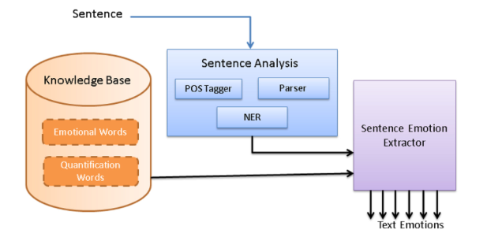
Knowledge based classification tool
Construct a tree and identify the grammatical role in a sentence
Identify named entities and analyze the relationship between the words
Construct a tree and identify the grammatical role in a sentence
Jaafer klila
Recognizing emotions in text
14

Slide 15
Evolution of results
After creation a dataset contains 750 instances of sentences form new headlines, twitter posts, article. The classifiers achive a good results as the table shows.
Accuracy | Classifier | Performance in
81% | Knowledge based | Headlines
87% | Naïve Bayes | Headlines
84% | MaxEnt | Headlines
Accuracy | Classifier | Performance in
80% | Knowledge based | Articles
85% | Naïve Bayes | Articles
82% | MaxEnt | Articles
Total accuracy: 86%
Total accuracy: 89%
Accuracy | Classifier | Performance in
71% | Knowles based | Tweets
81% | Naïve Bayes | Tweets
83% | MaxEnt | Tweets
Total accuracy: 82%
Jaafer klila
Recognizing emotions in text
15

Slide 16
Conclusion
The three classifiers Naïve Bayes, MaxEnt and Knowledge based tool achieve a good results for identifier the polarity of emotion
The model of Knowledge based tool can’t do well with Tweets because Tweets don’t follow the formal structure of a sentence.
Knowledge based tool use WordNet and manually added
words, authors decide to add more resource to get more better results
Knowledge based tool could not recognize some emotion in some sentence such as “I laughed at him” and
“He laughed at me” they will try to solve this problem.
Jaafer klila
Recognizing emotions in text
16

Slide 17

Achraf wali – Jaafer klila
Recognizing emotions in text
17

